Slide 1

URDU MACHINE READING COMPREHENSION (Research Based Project)
GROUP MEMBERS:
22-10457 (ERAJ KHURSHID)
22-10391 (SALMAN ANWAR)
22-10582 (ZAREK ASIF)
PRIMARY ADVISER: SIR ALI FAHEEM
SECONDARY ADVISER: SIR AKHEEM YOUSAF

Slide 2








OVERVIEW
PROBLEM STATEMENT
LITERATURE REVIEW
METHODOLOGY
EVALUATION
PROJECT MILESTONE
RESULTS
REFERENCES
QUESTIONS

Slide 3
PROBLEM STATEMENT
Machine Reading Comprehension (MRC), or the capacity to comprehend unstructured text and afterward answer questions concerning it stays a challenging task for computers. It’s the ability to read and understand text.
Lately, with the fast advancement of machine learning, particularly deep learning, the examination of machine reading comprehension has gained popularity, and it has arisen in reasonable approach
However, none of these models have been customized for the Urdu language.
We developed a dataset to give the accurate answers in question answering comprehension contexts.
The overall goal of the project is to create an Urdu Machine Reading Comprehension dataset that will answer questions automatically after reading the article with accuracy
To improve the accuracy of our answers, we use an Urdu dataset with AI models which include baseline techniques and transformer model.

Slide 4
Literature Review
In 2015, CNN / Daily Mail (Hermann et al. 2015) and SQuAD (Rajpurkar et al. 2016) two large scale dataset were introduced in the field of MRC.
UQuAD1.0 which helps to investigate the semi-computerized formation of Urdu comprehension.
SQUAD dataset, which is basically an English dataset, and it is translated into Urdu through two ways. One method is through machine and other was human based survey.
Riloff and Thelen (2000) presented a rule-based MRC system called Quarc.
Akour et al. (2011) introduced the QArabPro system, which is a system for answering reading comprehension questions in the Arabic language.
Ng, Teo, and Kwan (2000) have developed a machine learning based MRC system and introduced some of features to be extracted from a context sentence.
Two main deep learning architectures used by MRC researchers are the Recurrent Neural Network (RNN) and Convolutional Neural Network (CNN).

Slide 5


Dataset
The main challenge in Urdu MRC is non availability of database. So, we will be creating database using SQuAD dataset.
We translate SQuAD dataset by using google cloud platform.

Slide 6
Methodology
We will use different approaches for developing (Urdu Machine Reading Comprehension) system:
Rule based Models:
This Model use a set of Rules written by linguistic experts. These are unsupervised techniques. It includes:
Sliding window technique:
It is a rule-based solution to the answer extraction problem that requires essentially no pre-trained models.
The sliding window approach was chosen as the baseline since it is used in the SQuAD dataset and indicates that match frequency or basic word similarity between question and context cannot solve the RC problem.

Slide 7
Cosine similarity:
Regardless of paper size, the cosine similarity metric is used to determine how similar documents are.
It uses a numerical method to calculate the cosine of a point between two vectors projected in a multi-layered space.
Semantic embedding:
To quantify the semantic similarity of two texts. We pass the convert_to_tensor = True boundary to the encode work.
This will return a pytorch tensor containing our embeddings. We can then call util.cos_sim(A, B) which processes the cosine likeness between all vectors in A and all vectors in B.
It returns in the model a 3x3 network with the separate cosine similarity scores for all potential matches somewhere in the range of embeddings1 and embeddings2.

Slide 8
Deep learning Models:
It includes transformer models which require a large-scale training data to achieve high accuracy. The models include XLM-RoBERTa and mT5.
XLM-RoBERTa:
RoBERTa has a multilingual variant called XLM-RoBERTa. It has been pre-trained on 2.5 TB of filtered CommonCrawl data with 100 languages.
It is a self-supervised transformers model that was trained on a big dataset. This implies it was pre-trained on simply the raw texts, with no human classification (which is why it can use very much publically available data), and then used an automatic method to build inputs and labels from all those texts.
mT5:
mT5 is a multilingual Transformer model that has been pre-trained on a dataset (mC4) that includes text in 101 languages.
It was created to support any Natural Language Processing task (classification, question answering, etc.)

Slide 9

Evaluation
MRC Evaluation measures:
Three types of evaluation measures:
F1 Score
Exact Match
ROUGE-1

Slide 10
Evaluation Metrics
F1 score:
It considers the system output and the ground-truth answer as bag-of-tokens (words).
𝐹1 = 2 × 𝑝𝑟𝑒𝑐𝑖𝑠𝑖𝑜𝑛×𝑟𝑒𝑐𝑎𝑙𝑙
𝑝𝑟𝑒𝑐𝑖𝑠𝑖𝑜𝑛+𝑟𝑒𝑐𝑎𝑙𝑙
Exact Match (EM):
This is the percentage of answers that exactly match with the correct answers.
ROUGE-1:
It has a Precision and Recall measures how comparable reference and candidate summaries are in terms of uni-grams. When we say uni-grams, we simply mean that each comparison token is a single word.

Slide 11
Model results
Model Name | F1 Score | ROUGE-1 | Exact Match
Sliding Window | Slide 3: 0.6% Slide 5: 1.7% | Slide 3: 1.8% Slide 5: 3.4% | Slide 3: 0.01% Slide 5: 0%
Cosine similarity | 5% | 8% | 0%
Semantic embedding | 6% | 8% | 0.00175%
XLM-RoBERTa | 36% | 41% | 30%
mT5 | 73% | 73% | 64%

Slide 12
Number of answers predicted in text in each model:
Model Name | Number of answers in predicted text
Sliding Window | Slide-3: 1.1% Slide-5: 4.4%
Cosine similarity | 42%
Semantic embedding | 40%
XLM-RoBERTa | 66%
mT5 | 72%

Slide 13
Project Milestone
Several issues arose throughout the completion of this project:
Firstly, it is a massive undertaking. It was a challenging assignment to learn and put into practise. We have no experience with machine reading comprehension, particularly in the Urdu language and several modules.
Secondly, there is not a single dataset available on the internet because there is not much work done on this language. No codes or any machine learning, deep learning technique available on the internet.
Thirdly for the translation purpose we did not find any VISA card but after some days we get cards and use 2 VISA card for translation process and translate the English SQuAD dataset into Urdu dataset.

Slide 14
Lastly, Training and testing large amount of data on personal computers with limited amount of CPU and GPU processing was a very difficult task. creating a subset of data to be utilized for training and testing of model was proven impossible due to the need to use supervised learning for the model. In addition, creating such training and testing data could not be possible as creating a quality training data set requires time and large amount of effort as it would require manually going through thousands of texts as having a limited number of training dataset limited the vocabulary of the model.
We had many technical problems like working on code and all the errors.
We discovered a lot of new information, including how to use all of the components, libraries, and frameworks. We learned a crucial lesson: through togetherness, collaboration, and teamwork, we can achieve extraordinary things.

Slide 15
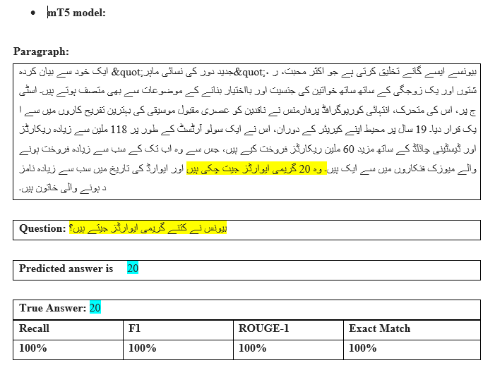
RESULTS mT5 Model

Slide 16
References
Trung, L. H. (2019). https://euroasia-science.ru/pdf-arxiv/the-controllability-function-of-polynomial-for-descriptorsystems-23-31/. EurasianUnionScientists, 4(65). https://doi.org/10.31618/esu.2413 9335.2019.4.65.27
CiteSeerX — query based Arabic text summarization 1. (n.d.). Retrieved December 6, 2021, from https://citeseerx.ist.psu.edu/viewdoc/summary?doi=10.1.1.308.4480.
Zhao, M., Yan, S., Liu, B., Zhong, X., Hao, Q., Chen, H., Niu, D., Long, B., & Guo, W. (2020, October 28). QBSUM: A large-scale query-based document summarization dataset from real-world applications. Computer Speech & Language. Retrieved December 6, 2021, from https://www.sciencedirect.com/science/article/abs/pii/S0885230820300991.
Kumar, Y., Kaur, K., & Kaur, S. (2021, February 12). Study of automatic text summarization approaches in different languages. Artificial Intelligence Review. Retrieved December 6, 2021, from https://link.springer.com/article/10.1007/s10462-021-09964-4.
Nawaz, A., Bakhtyar, M., Baber, J., Ullah, I., Noor, W., & Basit, A. (2020, September 25). Extractive text summarization models for Urdu language. Information Processing & Management. Retrieved December 6, 2021, from https://www.sciencedirect.com/science/article/abs/pii/S0306457320308785.

Slide 17

Any Questions

